Slide 1

Random Numbers
A potential advantage is that stream ciphers that do not use block ciphers as a building block are typically faster and use far less code than block ciphers
Randomness
Uniform distribution – the frequency of 1s and 0s should be almost equal
Independence - each number is independent of other numbers in the sequence and therefore unpredictable.
Pseudorandom Numbers - produce sequences of numbers that are not statistically random
Unpredictability
Forward unpredictability – If the seed is unknown, the next output bit in the sequence should be unpredictable in spite of any knowledge of previous bits in the sequence
Backward unpredictability - It should not be feasible to determine the seed from knowledge of any generated values

Slide 2
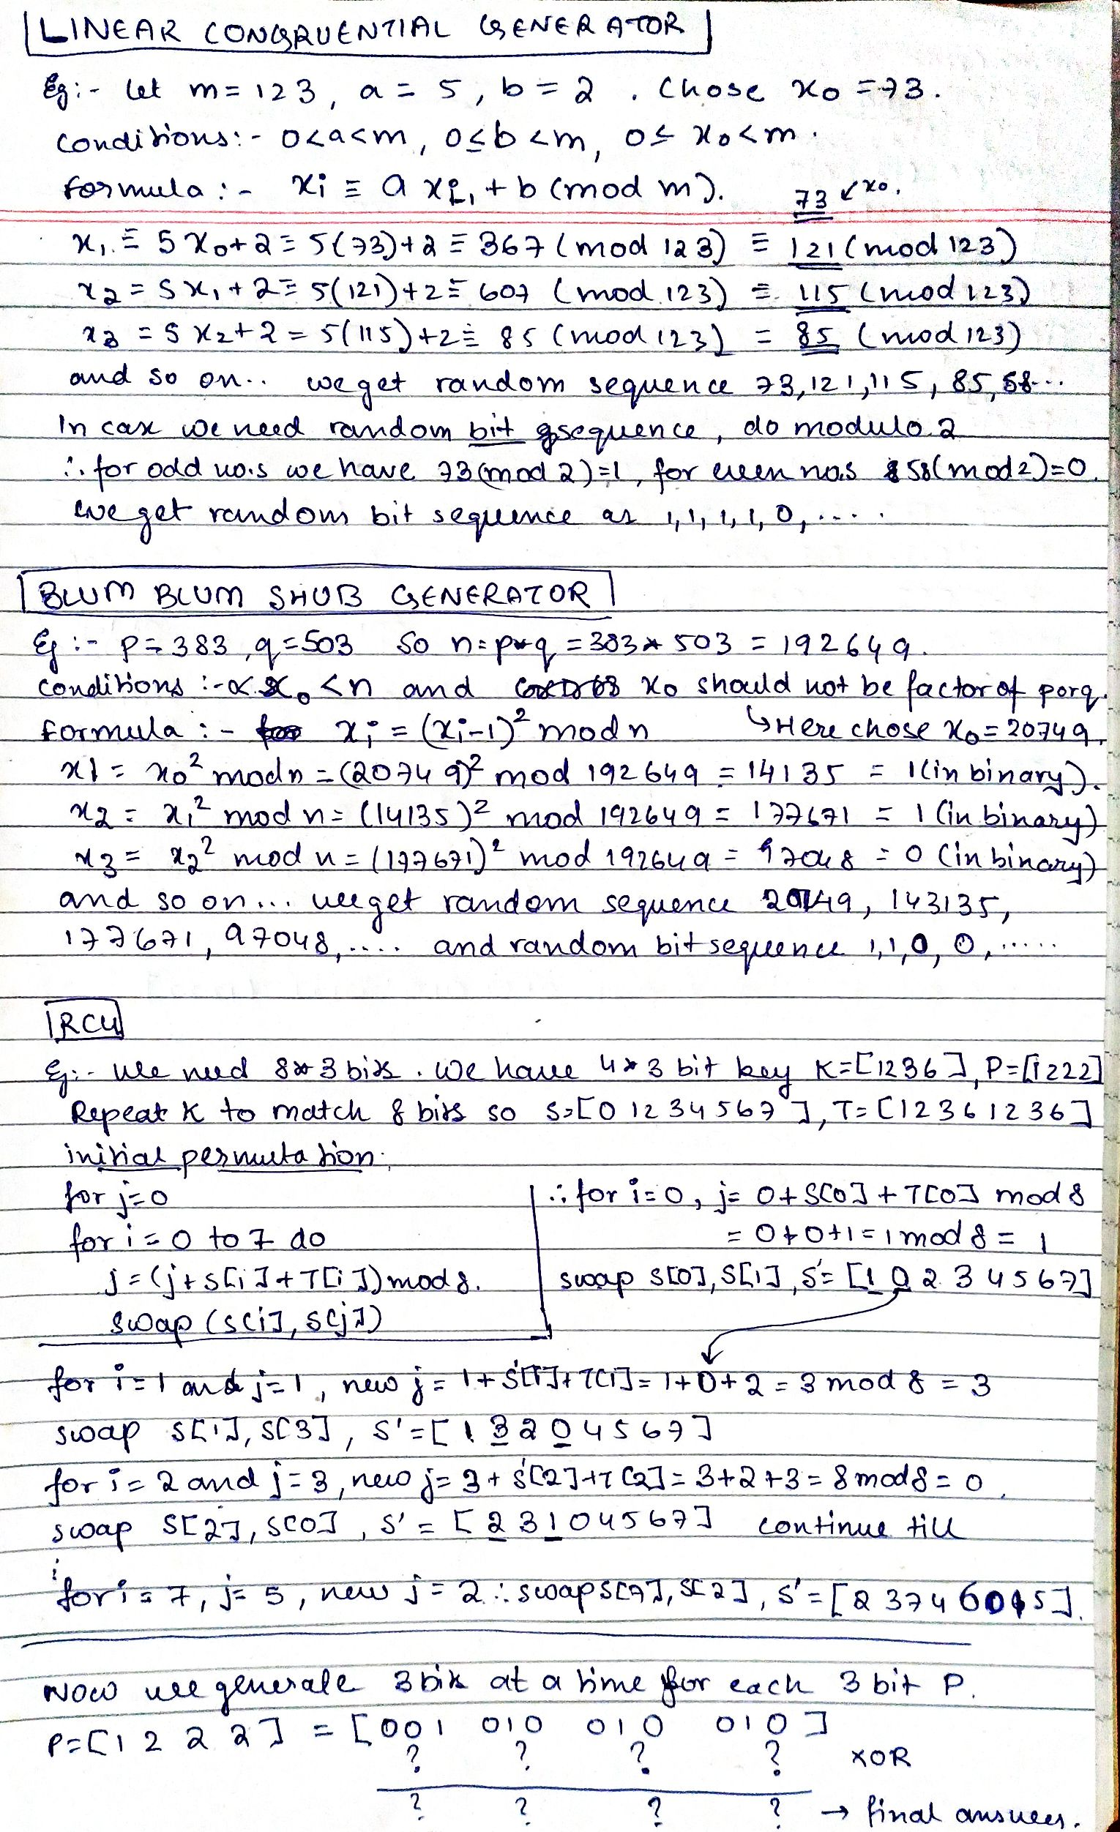
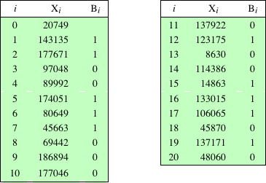

Pseudo Random Number Generators

Slide 3
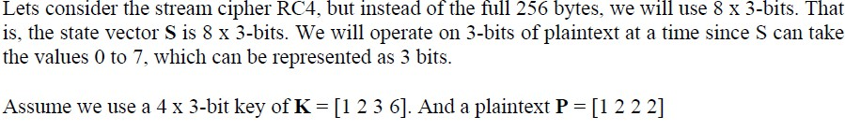
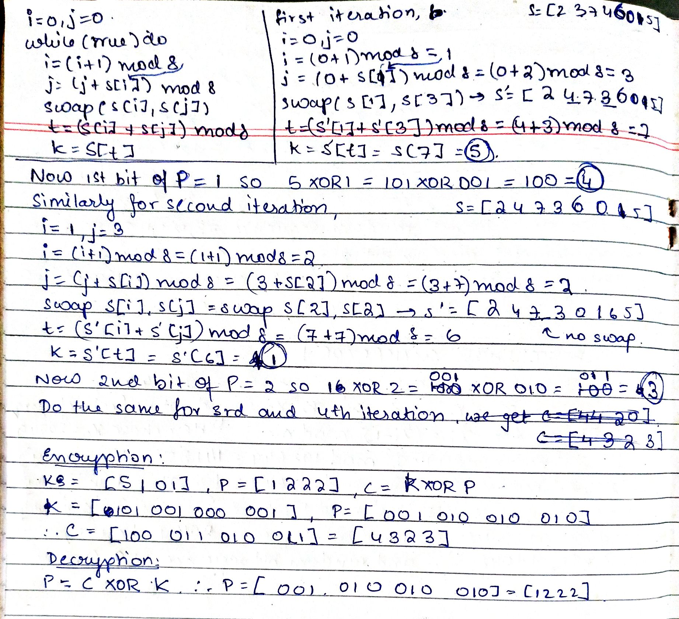
RC4
https://youtu.be/Pl-ySf5abv8?si=isjlxZyshZQkrct

